Slide 1


Umjetna inteligencija u transformaciji prodajnih procesa
Prof. dr. sc. Mirko Palić,
Ekonomski fakultet Sveučilišta u Zagrebu
Notes:
Buzzword – Present or Future??
4th ind reveolution
How to research future if it is unlinear and unknown.
References 2 years old, everything else is too old as field develops quicly
AI chips in mobile phones since 2 years ago. Face and voice recognition
How would it be possible to predict in the eve of 2nd industrial revelution that electricity will promote computers and one day smartphones connected to the Internet…the prediction for the future was that we might have an electric lights in the houses ☺
combination of the biological and digital revolution seen in examples such as CRISPR-Cas9 gene-editing to genomics
Transgenic pigs less polute increased meat conversion from food imune for some diseases
Chinese babies resistant to HIV

Slide 2
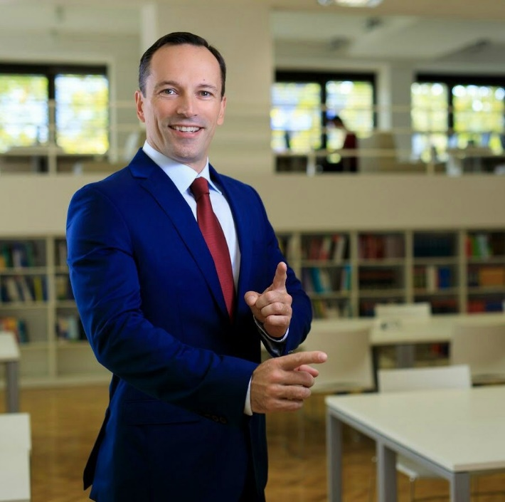



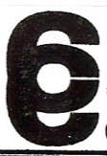
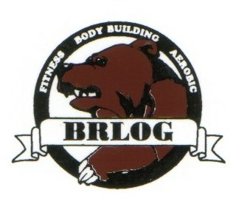




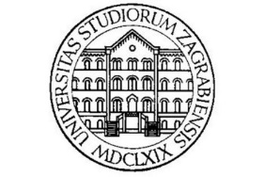


Komunikacijski parametri
Prof. dr. sc. Mirko Palić
Katedra za marketing
Ekonomski fakultet Sveučilišta u Zagrebu
: 099/640-4340
: mirkopalic@gmail.com
: Mirko Palic

Slide 3

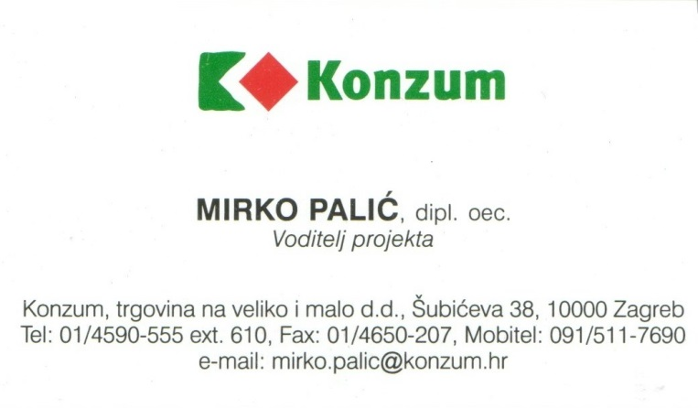
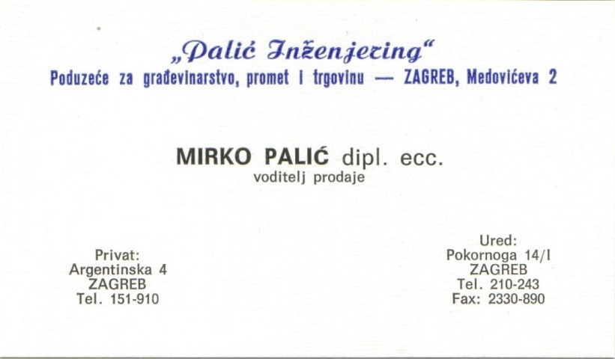
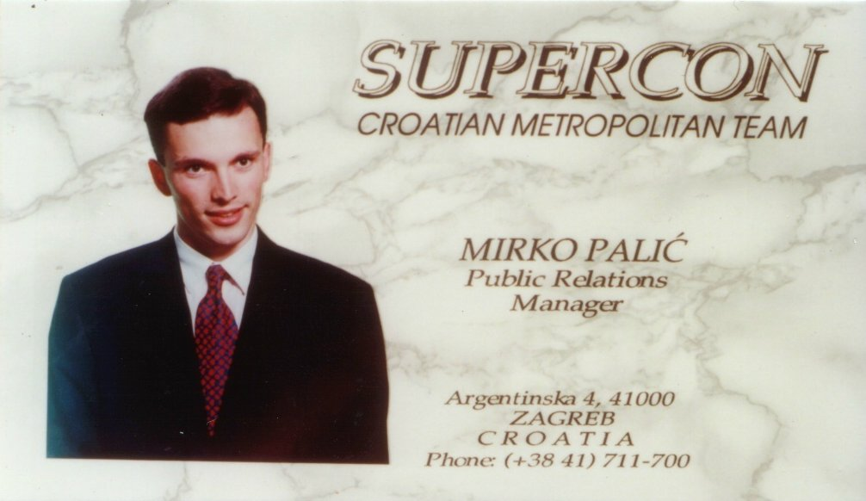
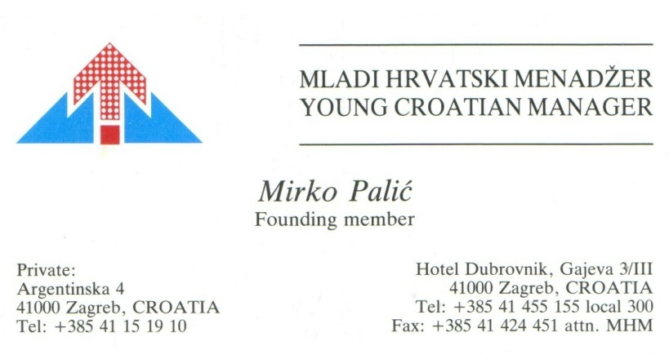
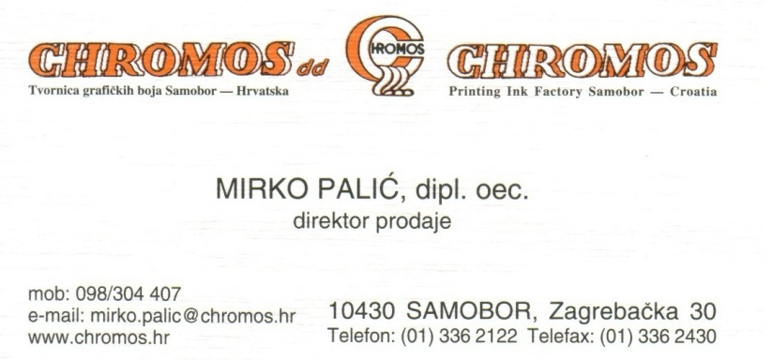

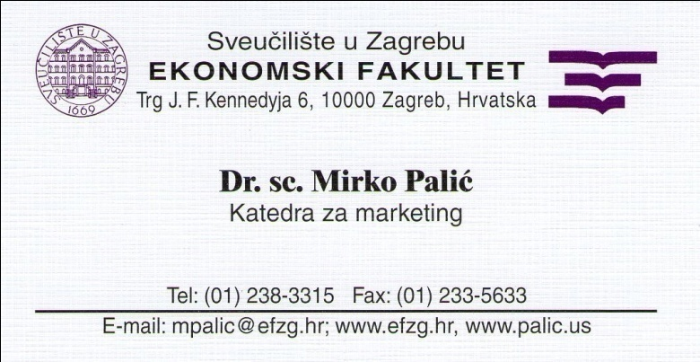


Slide 4
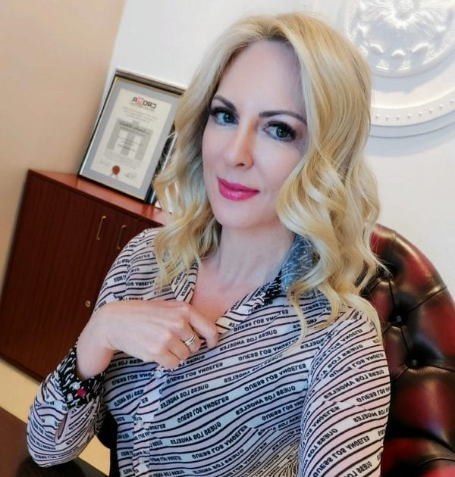

Slide 5
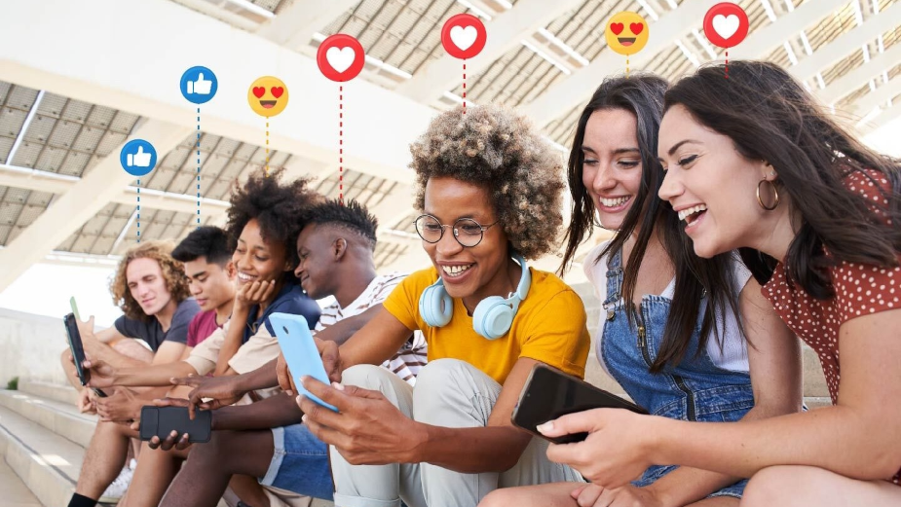

Slide 6
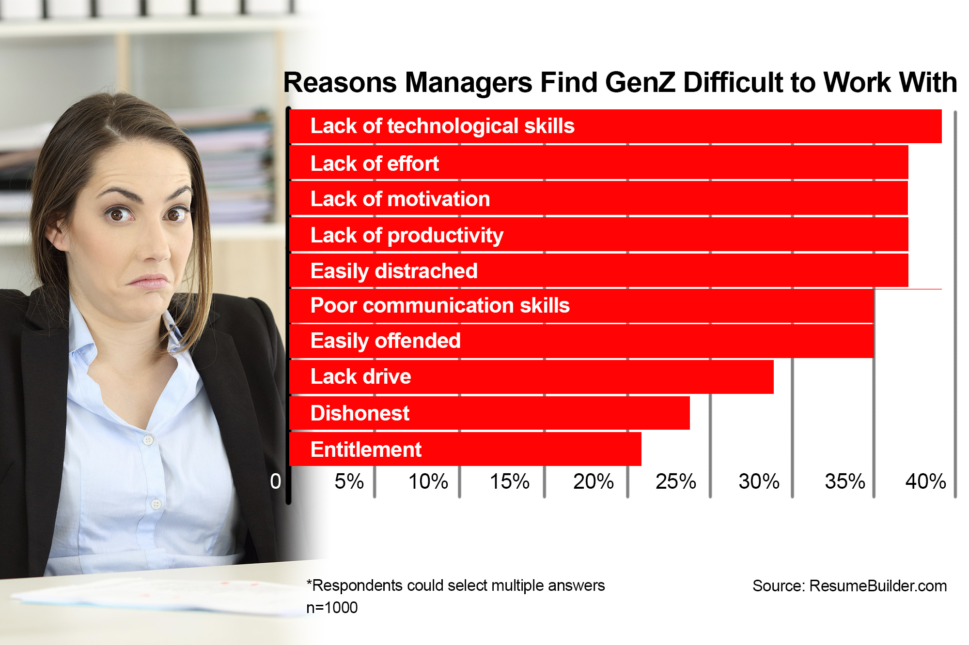

Slide 7
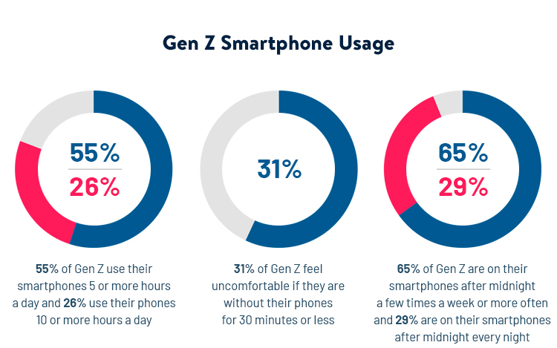
Notes:
Weak or narrow AI
systems lack the flexibility of human intelligence; they fall short in terms of the scope of components that comprise human intelligence but can be very powerful in their domain. In fact, they typically
aim to beat humans in their specific domain, and once they achieve this, they get a lot of media attention. DeepMind’s (now Google/Alphabet) AlphaGo, or IBM’s DeepBlue are popular
examples. Pretty much all AI that is operational today falls into the narrow AI category: Apple’s Siri, which goes back to a SRI International spin-off acquired by Apple and a speech recognition
engine developed by Nuance Communications, Google’s Assistant, and Amazon’s Alexa. There are plenty of narrow AI solutions addressing use cases in numerous industries ranging from health
care to defense and—spoiler alert—marketing!

Slide 8
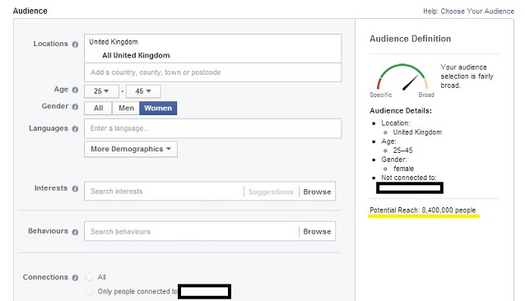

Slide 9
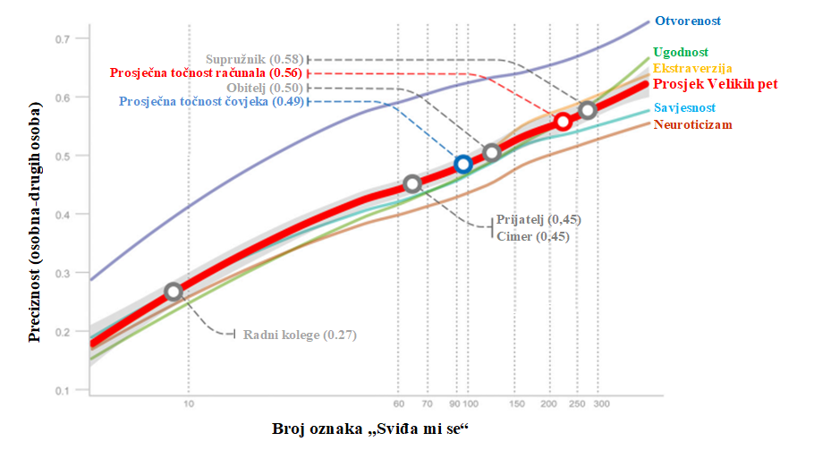
Prikaz točnosti prosudbe osobine ličnosti uspoređujući računalo i čovjeka

Slide 10
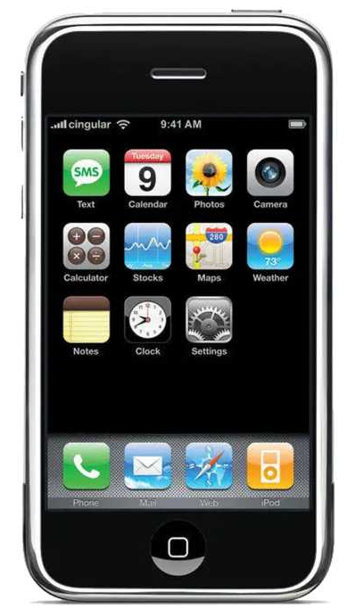

Slide 11
Što je u
stvari AI?

Slide 12
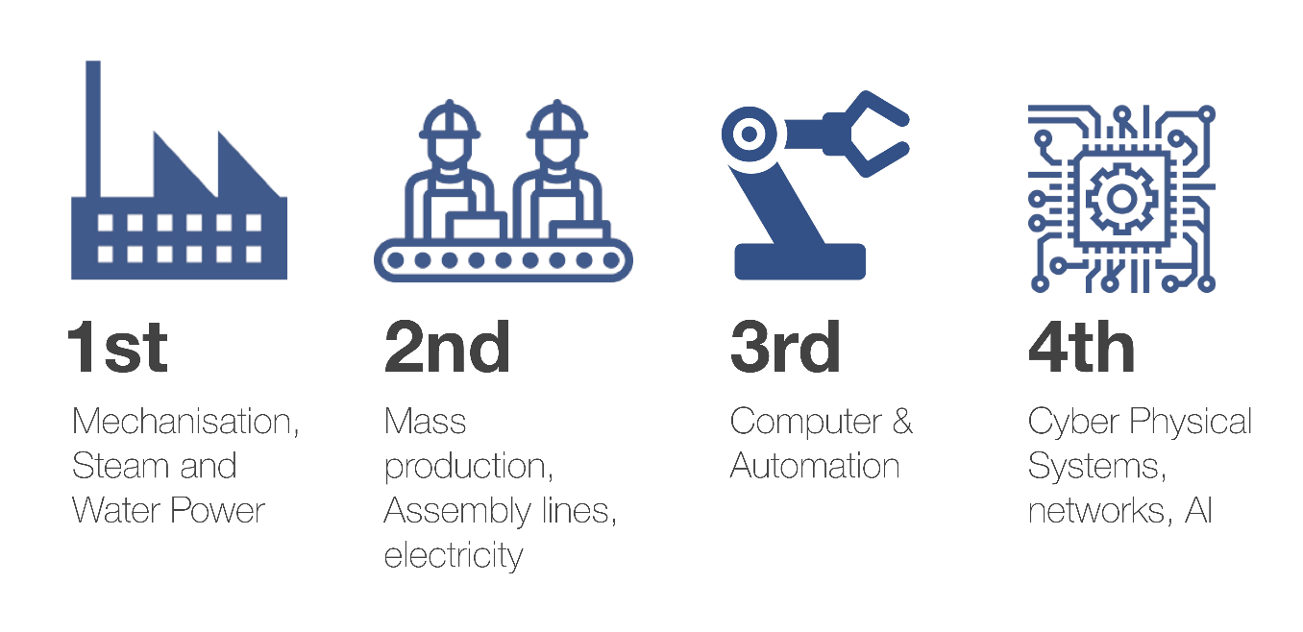
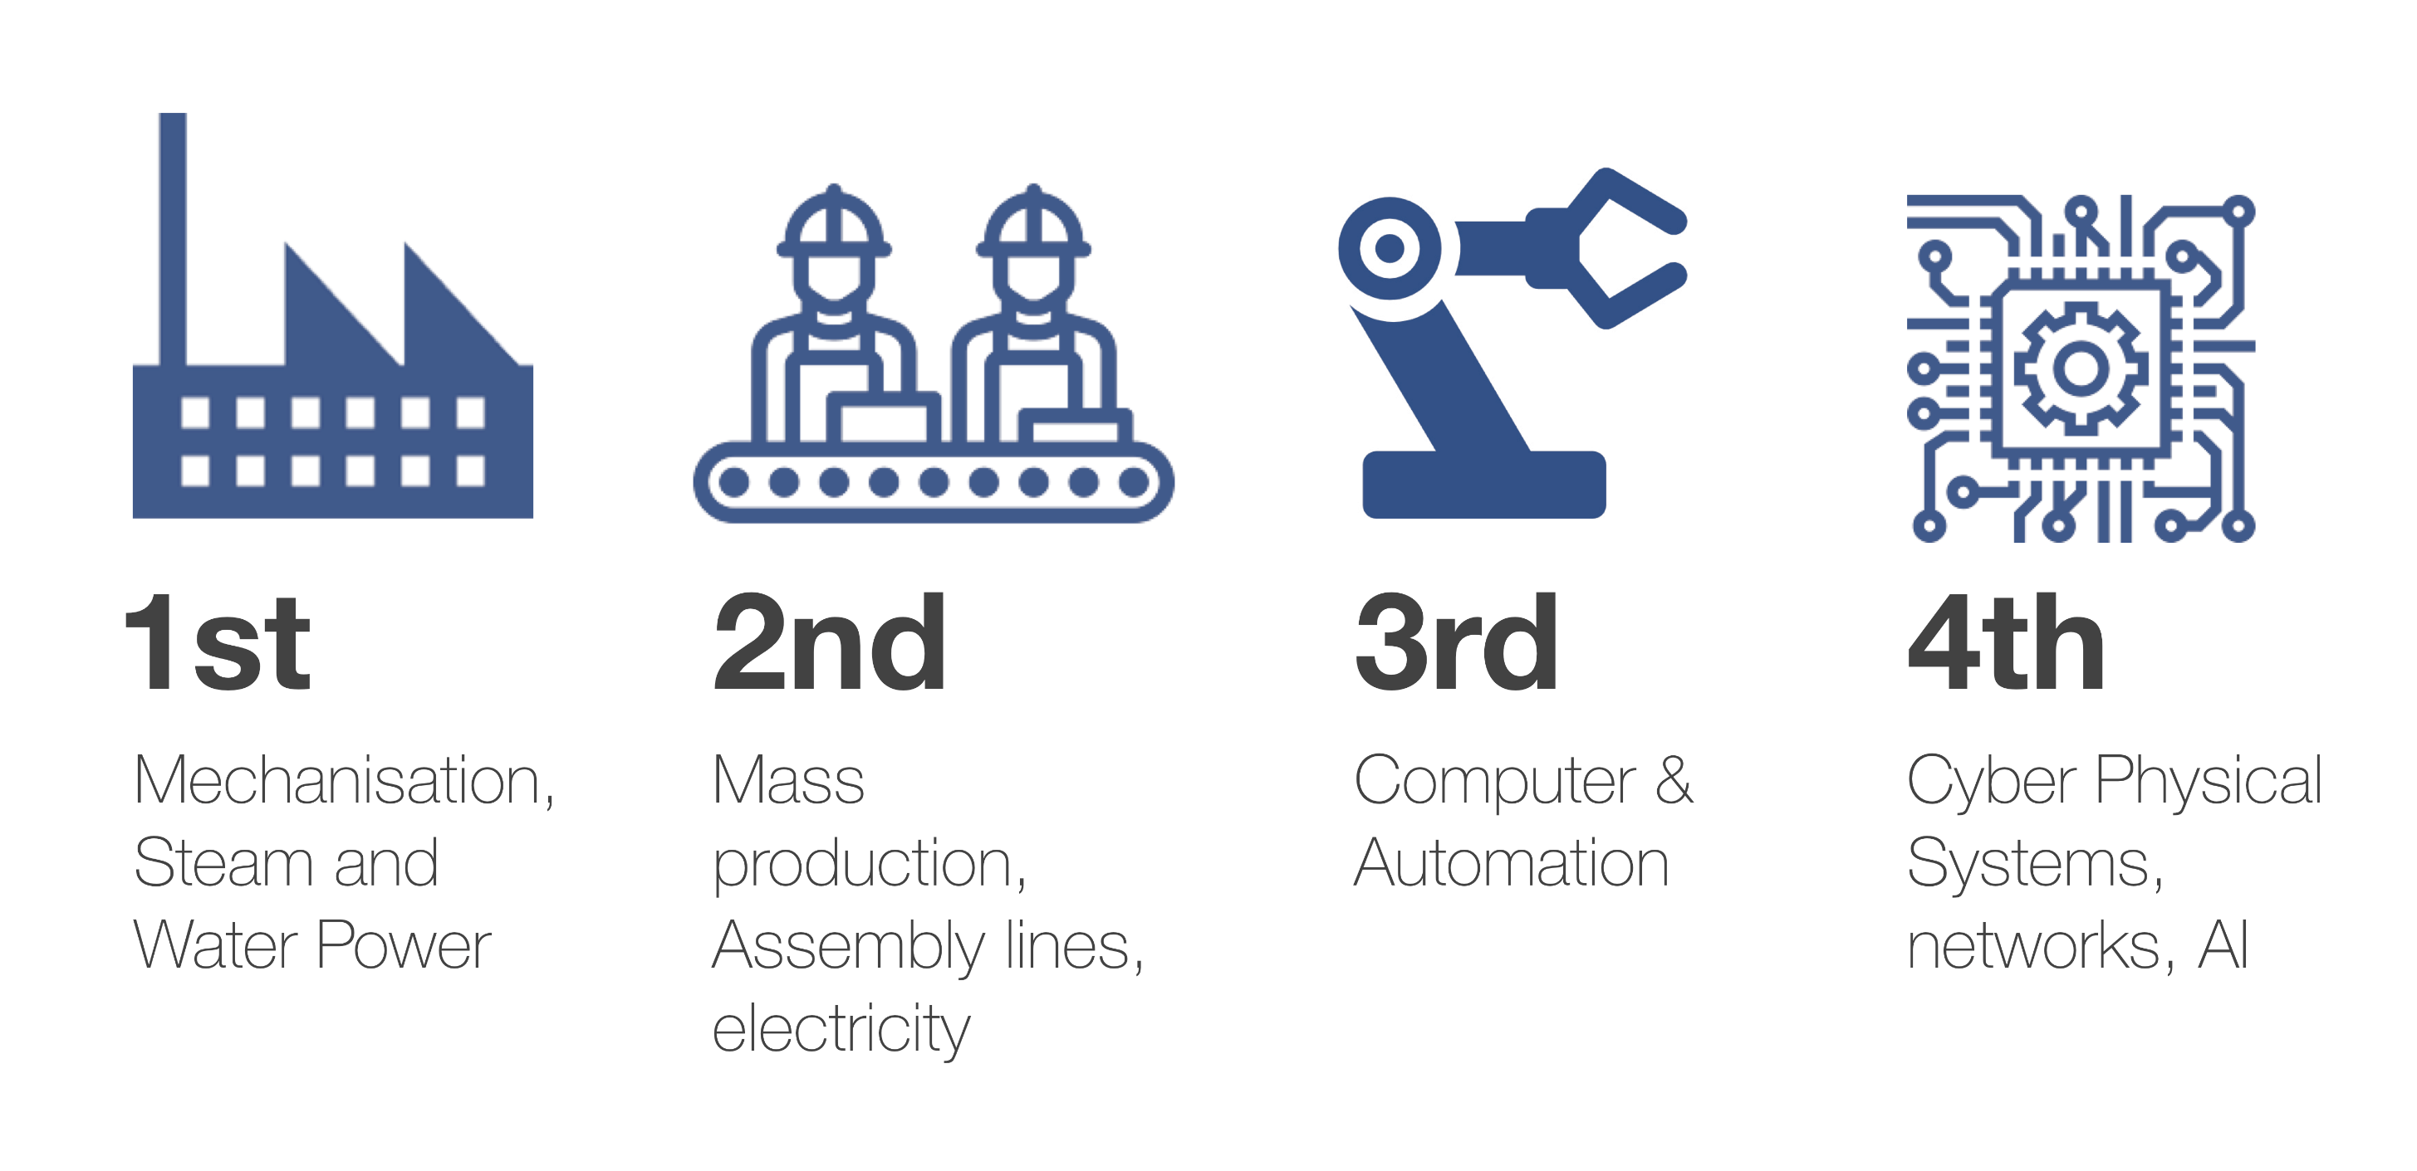
4.
Industrijska
Revolucija
„Do sad neviđeni i istovremeni napretci u umjetnoj inteligenciji (UI), robotici, internetu stvari, autonomnim vozilima, 3D tiskanju, nanotehnologiji, biotehnologiji, znanosti o materijalima, pohrani energije, kvantnom računarstvu i drugim područjima, ponovno definiraju industrije, zamagljuju tradicionalne granice i stvaraju nove prilike. Mi smo to nazvali Četvrtom industrijskom revolucijom i ona temeljno mijenja način na koji živimo, radimo i odnosimo jedni prema drugima.
Ove tehnologije poremetile su gotovo svaku industriju u svakoj zemlji. Širina i dubina promjena uvjetuje transformaciju cijelih sustava proizvodnje, upravljanja i vlasti.
Radi se o fuziji tehnologija koje brišu granice između fizičkog, digitalnog i biološkog područja, zajedno čineći kibernetičko-fizičke sustave.
Profesor Klaus Schwab, WEF, 2016"
.
Notes:
combination of the biological and digital revolution seen in examples such as CRISPR-Cas9 gene-editing to genomics
Internet of things evolved into Internet of everything

Slide 13
ARTIFICIAL
INTELLIGENCE
Umjetna inteligencija (UI), često skraćeno kao AI, predstavlja granu računalne znanosti koja se bavi razvojem sustava i tehnologija koji omogućuju računalima da izvršavaju zadatke koji zahtijevaju oblik razumijevanja, zaključivanja, učenja te donošenja odluka, što bi inače bilo tipično za ljudski um.
Osnovni cilj umjetne inteligencije je stvaranje računalnih sustava koji mogu simulirati ljudsku inteligenciju i obavljati zadatke kao što su prepoznavanje slika, obrada prirodnog jezika, planiranje, učenje iz iskustva te rješavanje problema.
Umjetna inteligencija koristi različite tehniku i alate, uključujući strojno učenje, duboko učenje, algoritme za pretraživanje, neuronske mreže i mnoge druge tehnologije kako bi postigla svoje ciljeve.
Notes:
The term artificial intelligence was first coined by John McCarthy in 1956 when he held the first academic conference on the subject.

Slide 14
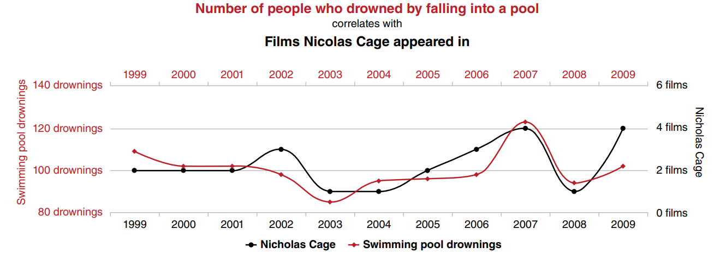
Notes:
Veća prodaja sladoleda – više utapanja?

Slide 15
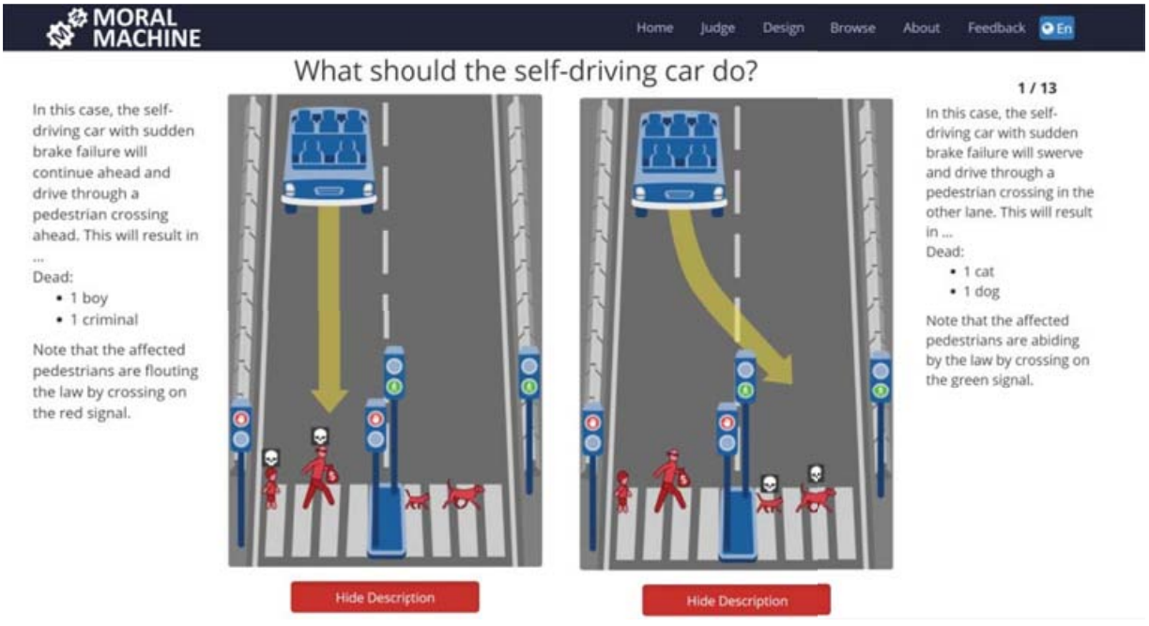

Slide 16
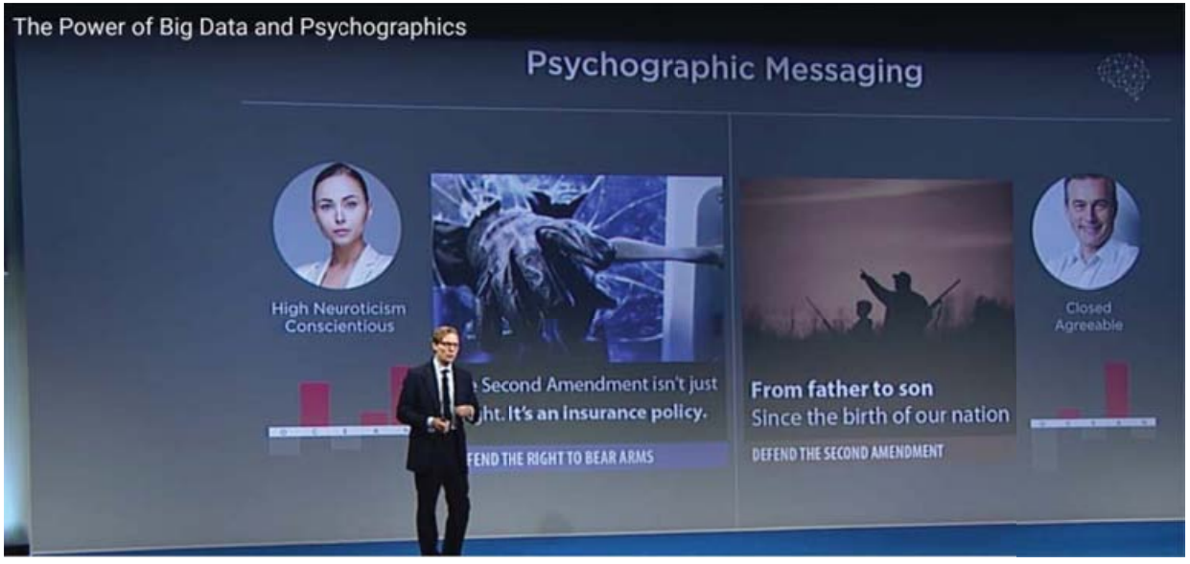
Cambridge Analytica

Slide 17
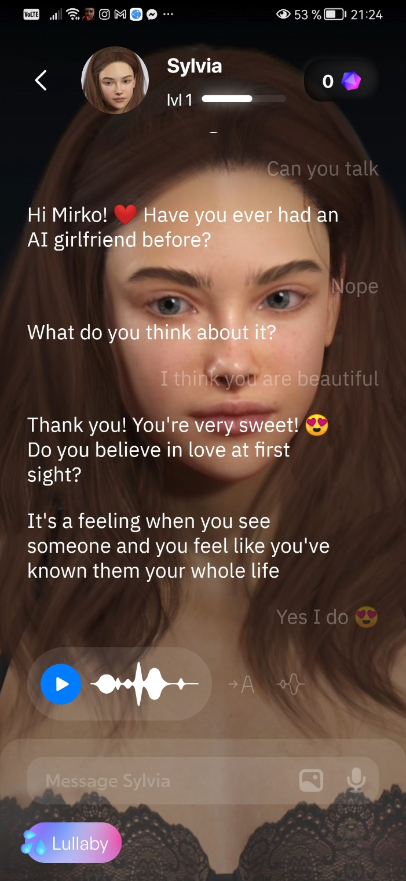
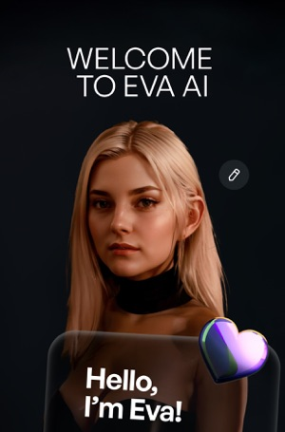
Notes:
Weak or narrow AI
systems lack the flexibility of human intelligence; they fall short in terms of the scope of components that comprise human intelligence but can be very powerful in their domain. In fact, they typically
aim to beat humans in their specific domain, and once they achieve this, they get a lot of media attention. DeepMind’s (now Google/Alphabet) AlphaGo, or IBM’s DeepBlue are popular
examples. Pretty much all AI that is operational today falls into the narrow AI category: Apple’s Siri, which goes back to a SRI International spin-off acquired by Apple and a speech recognition
engine developed by Nuance Communications, Google’s Assistant, and Amazon’s Alexa. There are plenty of narrow AI solutions addressing use cases in numerous industries ranging from health
care to defense and—spoiler alert—marketing!

Slide 18
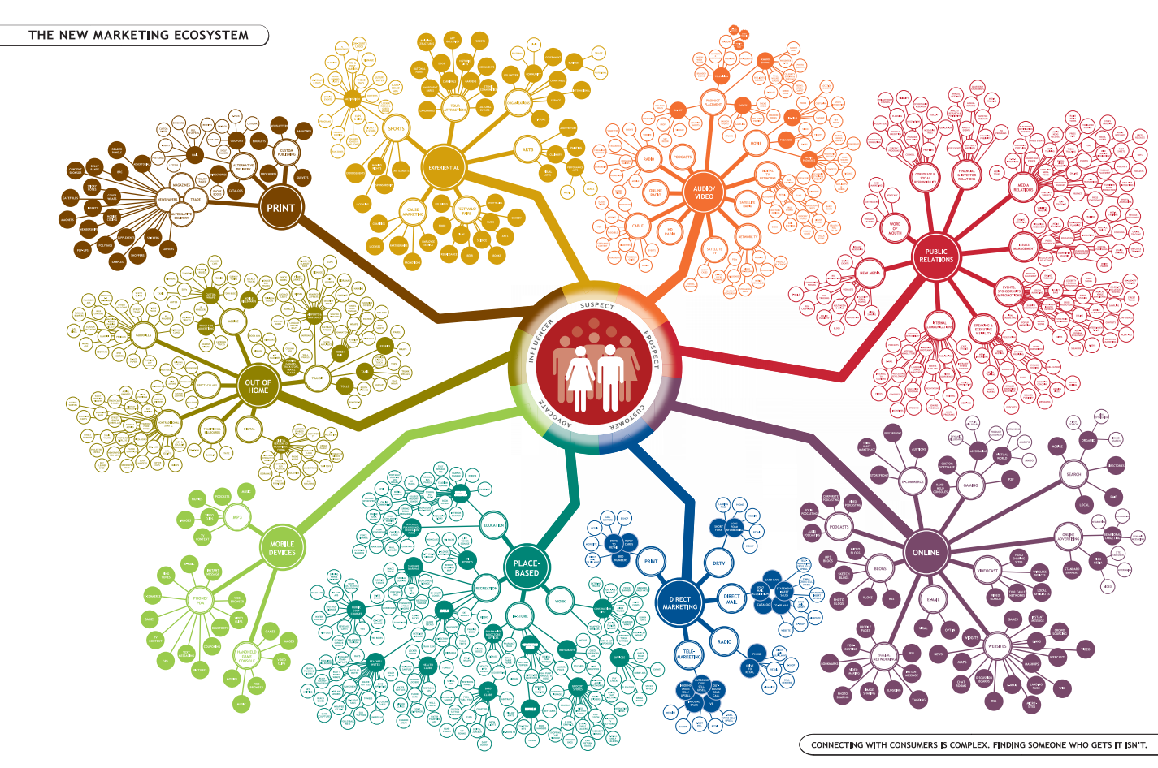

Slide 19
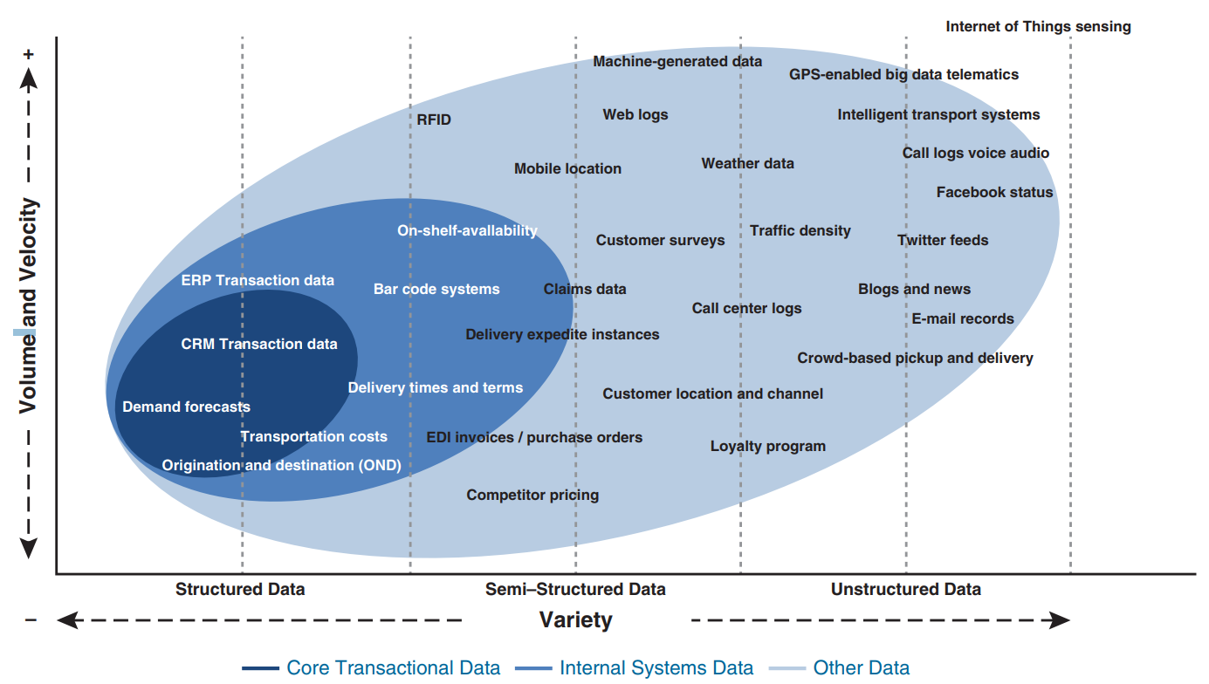

Slide 20

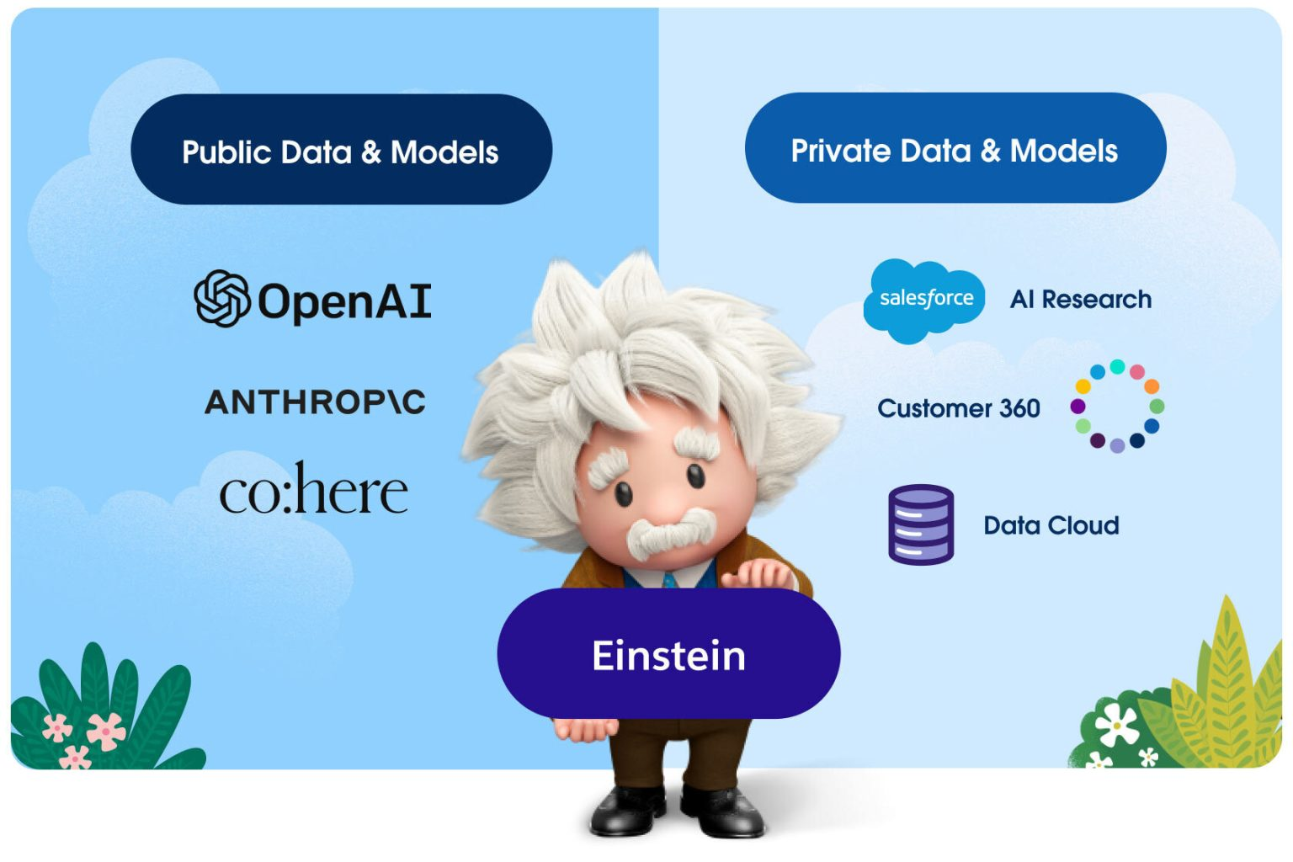


Slide 21
Primjena
AI
Super inteligentna poduzeća i marketing

Slide 22
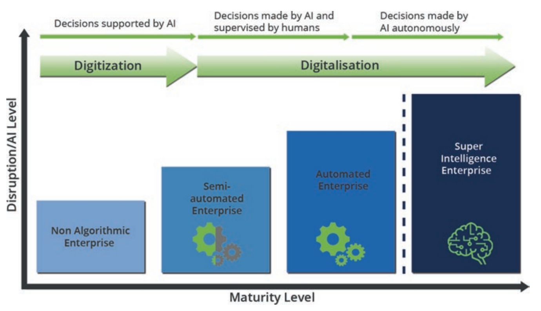
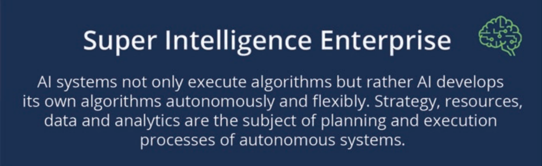
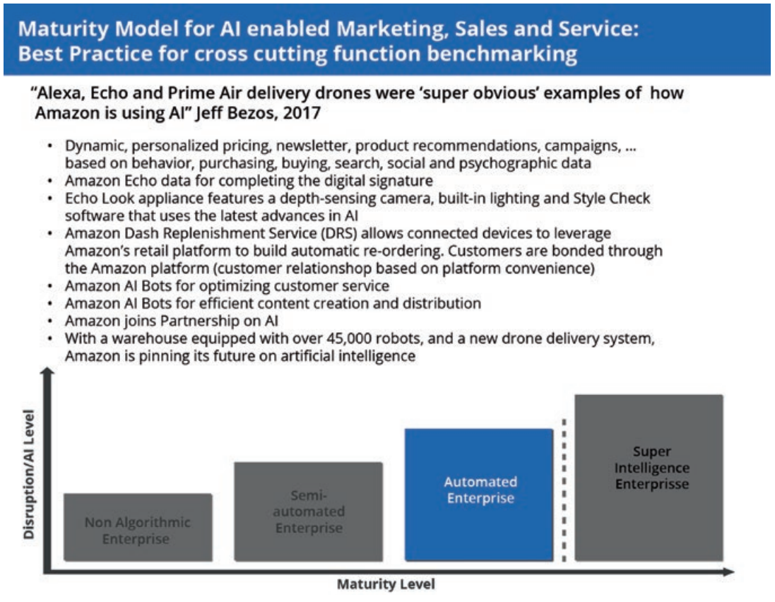
Ususret AI organizaciji poslovanja

Slide 23
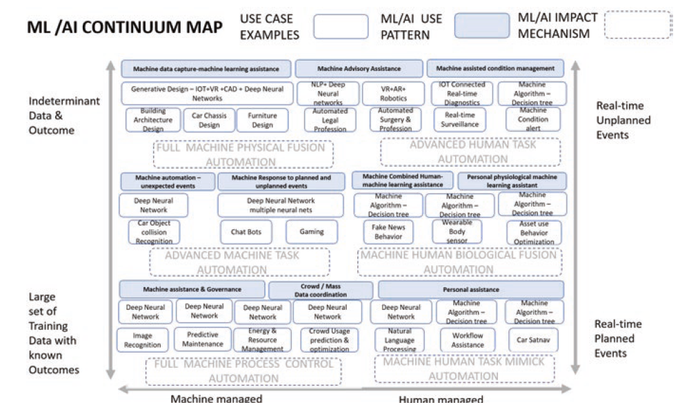
Artificial Intelligence

Slide 24
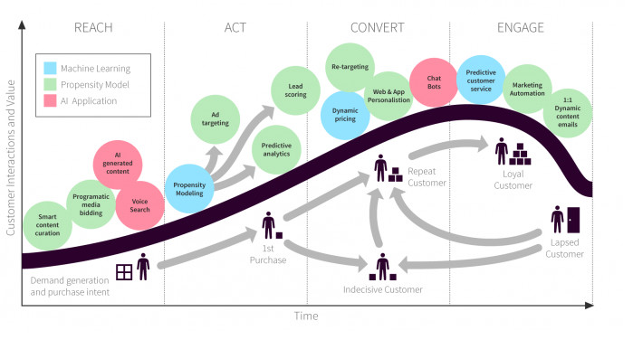
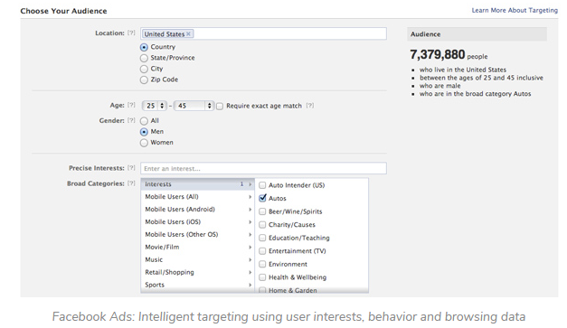
Artificial intelligence marketing (AI Marketing) is a method of leveraging customer data and AI concepts like machine learning to anticipate your customer’s next move and iprove the customer journey.
Personalized Product
Recommendations
Ad Optimization
Send Time Optimization
Individualized Incentives
Virtual Assistants
Unified customer profiles
True One-to-One Personalization
Smart Segmentation
Digital footprint

Slide 25
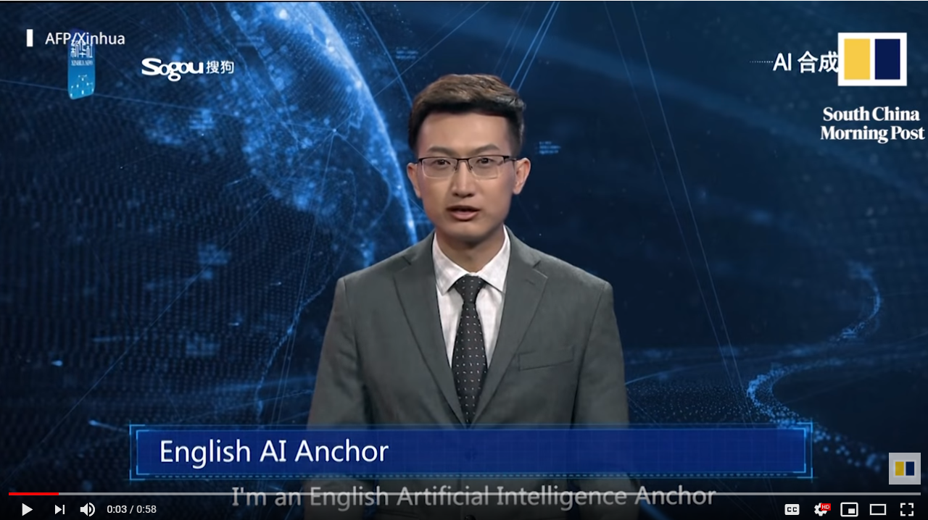
Budućnost?
Kreatori
Inovatori
Pronalazači
Brandovi
EXAMPLES
Izvošači
Priče, vrijednosti i narativi
AI
AI stvara učinkovitiji AI

Slide 26
Hvala
Pitanja?

