Slide 1
CEREC Primescan
Dr Jovana Radosavac
Dr Alica Soltyšik

Slide 2
Protokol skeniranja

Slide 3
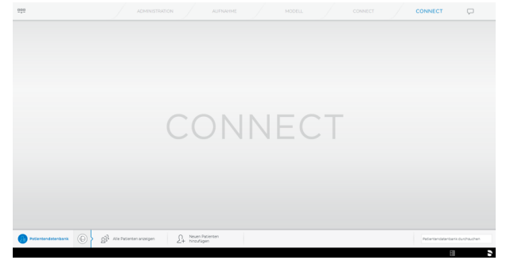
1. CONNECT SW
2. ADD NEW PATIENT
  ime i prezime,
  datum rođenja,
  doktor
  add new case
3. SHOW PATIENT
  pretraga baze pacijenata po doktorima

Slide 5

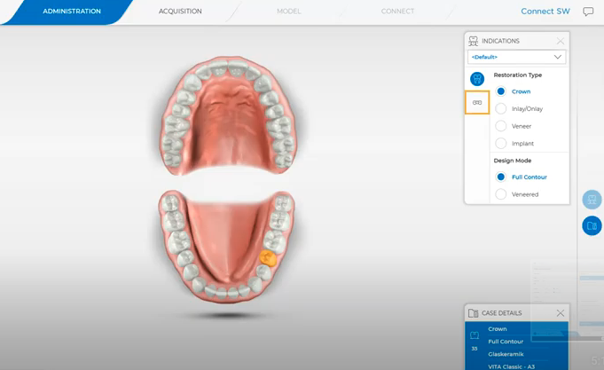
4. ADMINISTRATION
Single tooth restoration
  Full contour / veneered
  Select the tooth for which the restoration is to be created - the selected tooth is marked
  Select material
  Select shade

Slide 6
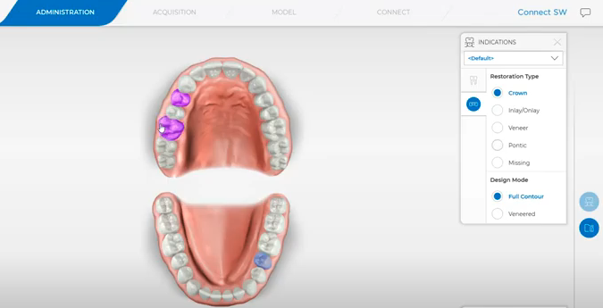
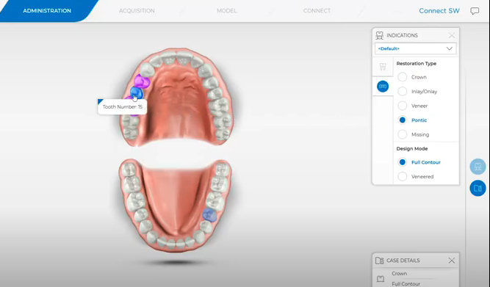
4. ADMINISTRATION
Bridge restoration
  FIRST select the positions of the abutment teeth (crown full contour)
  and than the pontic
  Select material
  Select shade

Slide 7
4. ADMINISTRATION
Full arch scan mode
If no bridge or individual restoration is selected, you are automatically in this mode
You can send this scan to the laboratory without making any further selections
Aligners
Splints
Individual impression trays
Selecting the scanbody type (only for abutments)
  You can select the desired scanbody type in this step. In addition to TiBase and ScanPost, you can also select IO FLO and "Other" to use an intraoral scanbody from another provider.

Slide 8

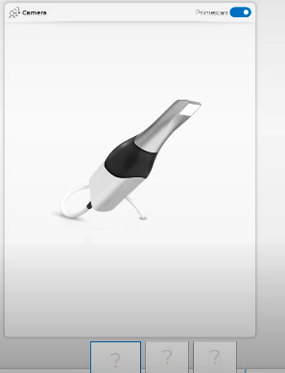
5. ACQUISITION
Osnovni katalog:
Lower Jaw
Upper Jaw
Buccal
  Pacijent u uspravnom sjedećem položaju
  Skenirati u zagrizuzube gornje i donje čeljusti najbolje u PREDJELU PREMOLARA
  Kad skener spoji čeljusti može se sa suprotne strane isto odskenirati predio premolara
  Ne skenirati kompletan zubni luk u zagrizu- ,,previše info za skener’’
  Ako je dobro skenirano kvačica je ZELENA i može se dalje nastaviti
    Inače je ,,znak opće opasnosti’’

Slide 9
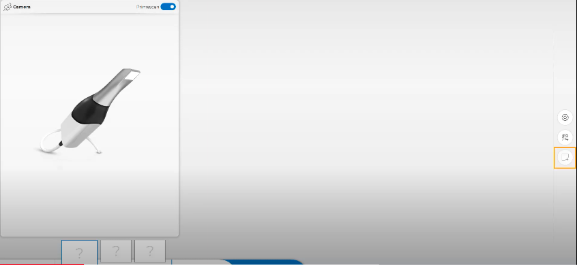
5. ACQUISITION
Dodatni katalog
BioRef Lower
BioRef Upper
BioCopy Lower (koristimo za situaciju7prototip)
BioCopy Upper (koristimo za situaciju7prototip)
Gingiva Mask Lower Jaw
Gingiva Mask Upper Jaw
Scanbody Lower
Scanbody Upper Jaw
*** ako je skenirana situacija, kad se vratimo u acquisition prvo kliknuti na UNLOCK pa onda dodati katalog

Slide 10
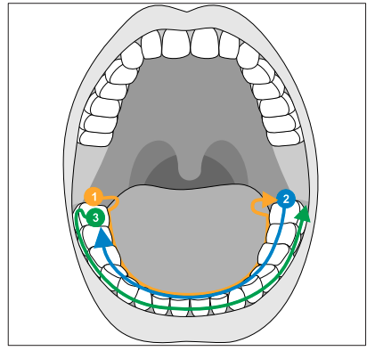
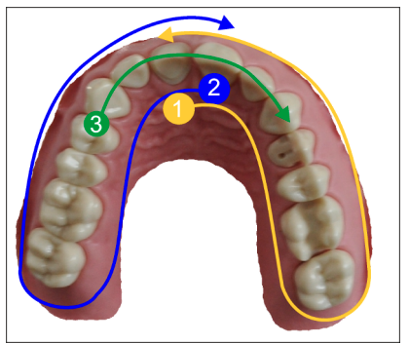
Different scanning procedures
Square and full jaw scan

Slide 11
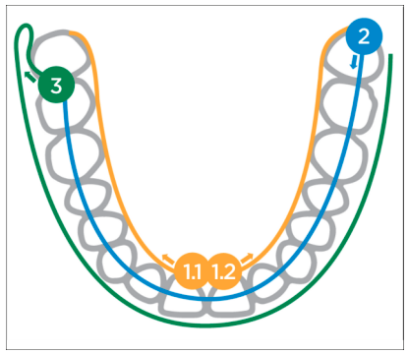
Different scanning procedures
Bezuba čeljust

Slide 12
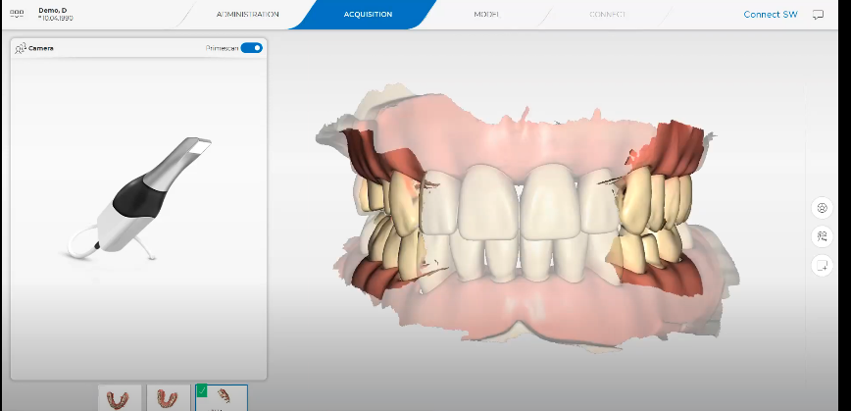


Slide 13

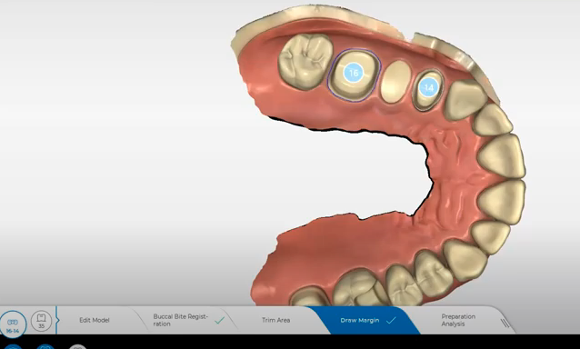
6. MODEL
Edit model

Slide 14
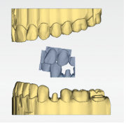
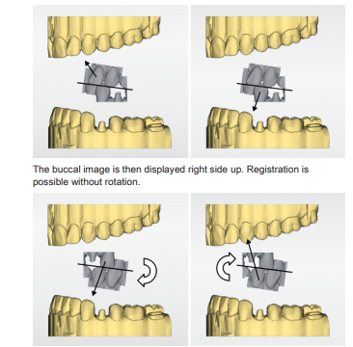
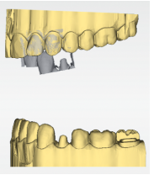
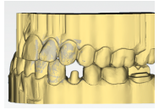
6. MODEL
The buccal registration of the bite situation
  The software joins the models together automatically und shows this with a green check mark at the buccal window
  If this is not possible you can correlate the models together manually

Slide 15

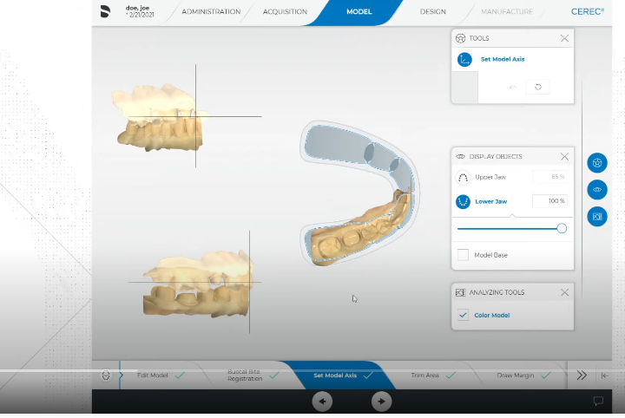

6. MODEL
Set model axis
Trim area
Cut:
  begin the cut with a double-click on TOUCH PAD-u;
  set aditional points
  finish by double clicking
Trim - isolate the preparation

Slide 16
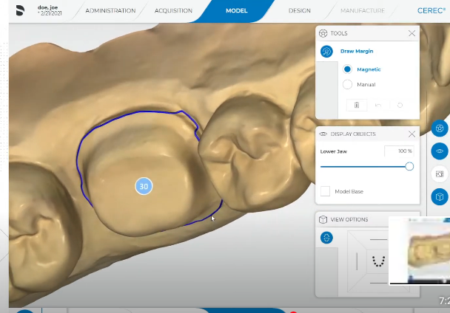


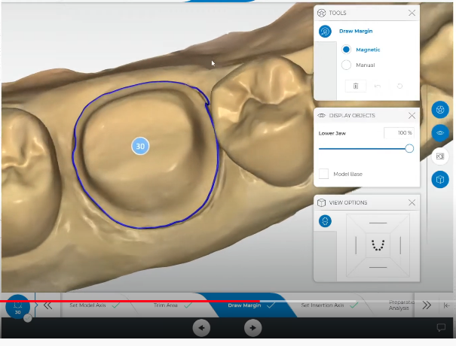
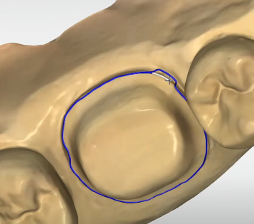
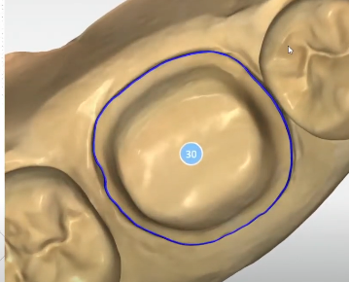
6. MODEL
MANUAL:
Double left click
Left click
Finish with double left click
Draw margin

Slide 17
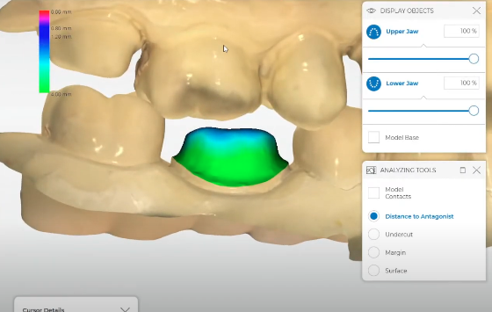
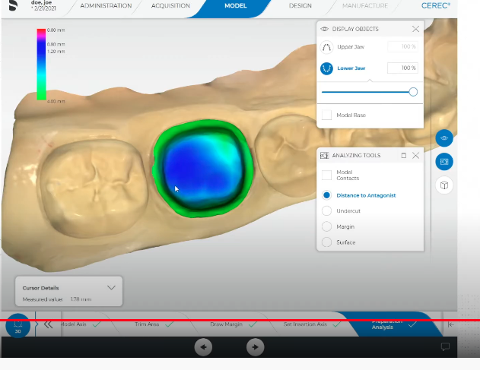
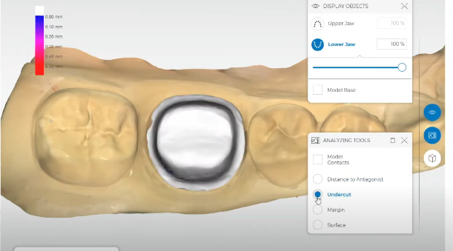
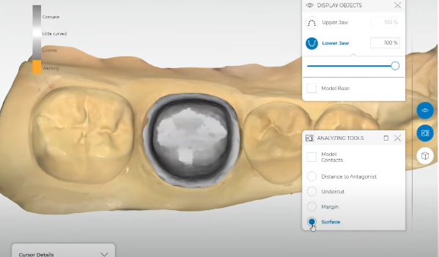
6. MODEL
Preparation analysis
Distance to antagonist
Undercut
Margin
Surface

Slide 18
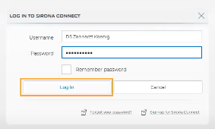

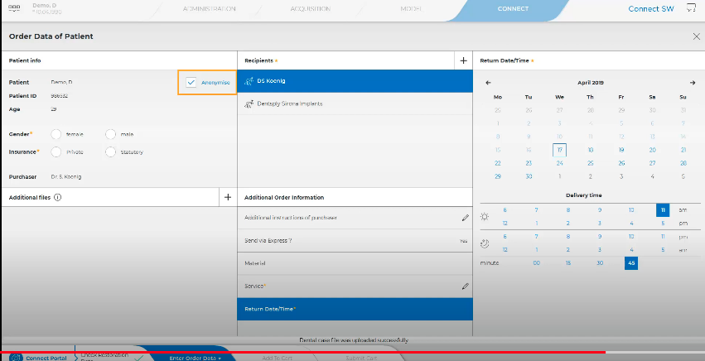
7. CONNECT
Desno na ekranu:
Return Date – sljedeći dan
Additional instructions of purchaser
  Koji dr je skenirao (naš labos ne vidi raspodjelu po doktorima)
  Dodatne info o radu
Lijevo:
Odznačiti ,,anonimyze’’

Slide 19

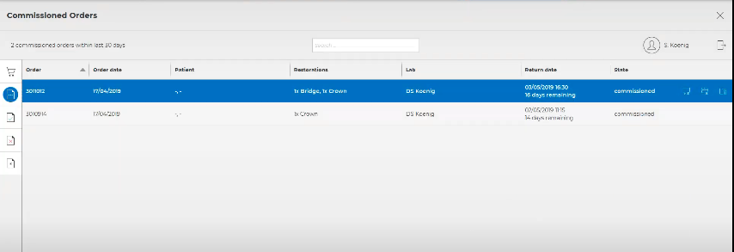
7. CONNECT
Add to Cart
Submit cart
Order list
Commissioned

Slide 20
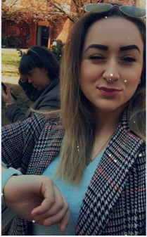
Hvala za pažnju

